Slide 1
Dashboard Project Overview: Transforming Data into Insights
By simarpreet kaur

Slide 2
Visual used
Cards
Bar chats
Line chart
Pie chart
Donut chart
Stacked area chart

Slide 3
New Measures: Enhanced Sales Analysis
Average Sales by Product
Calculate average sales across products for trend analysis.
Total Sales for Product
Sum sales data for each product to gauge volume.
COGS Max per Inventory Margin
Identify maximum COGS relative to inventory margin percentage.

Slide 4
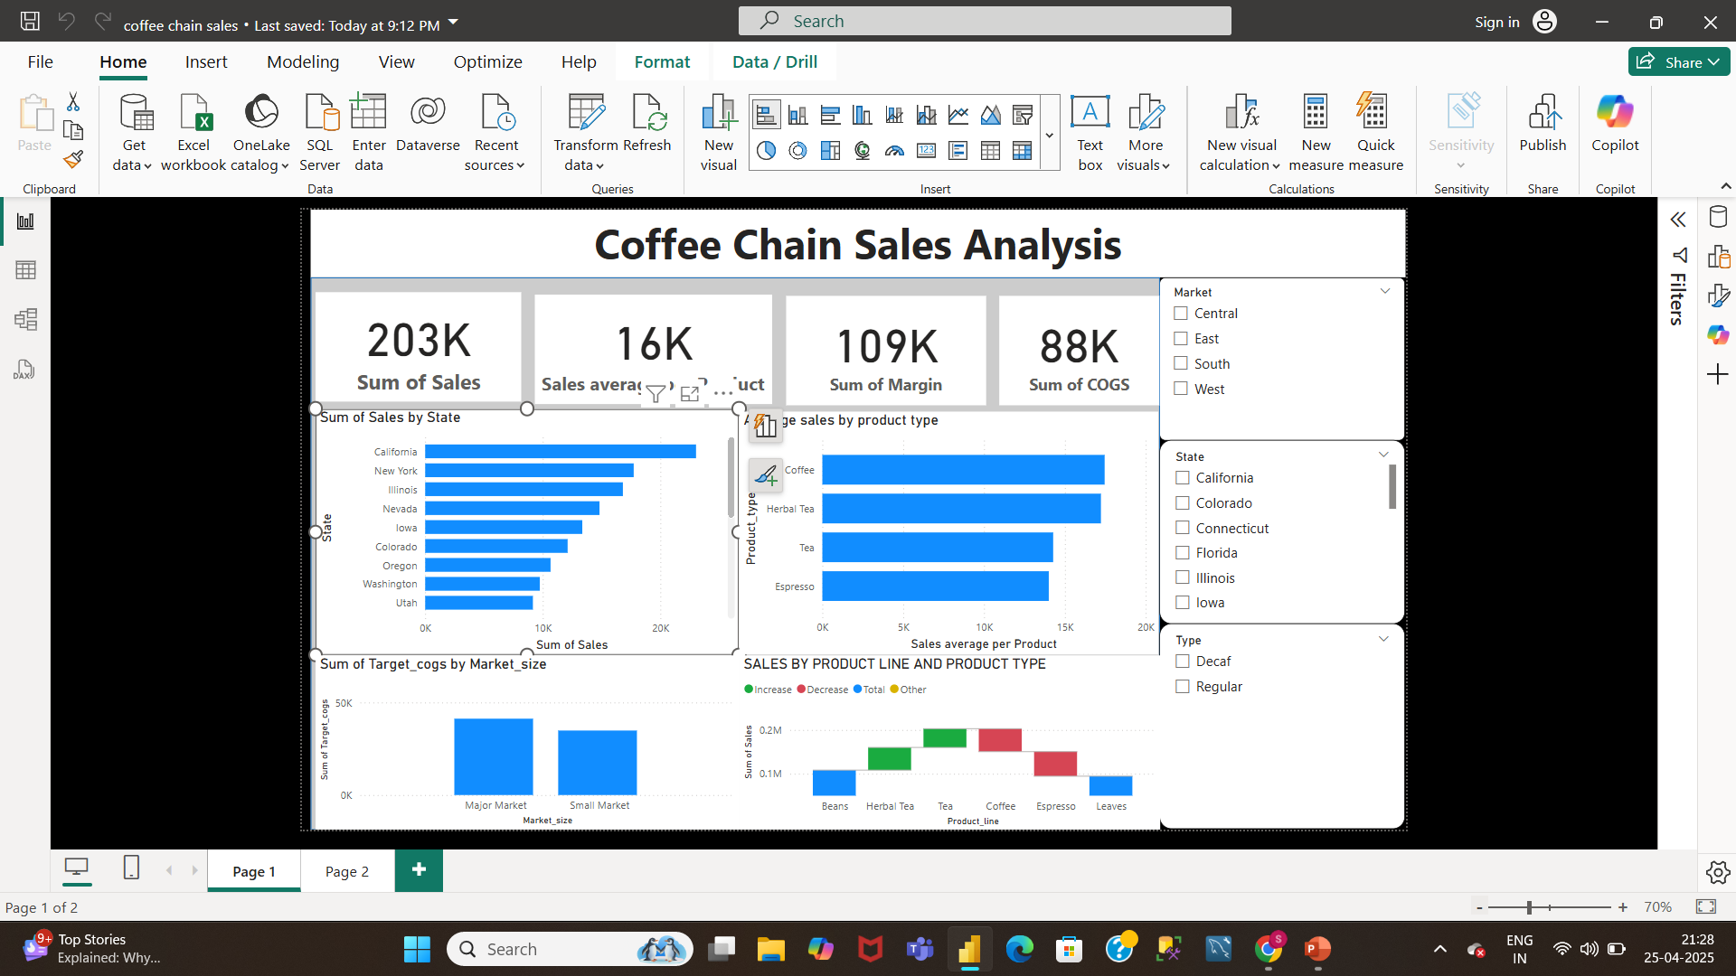
Chart 1: Sum of Sales by State Chart 2 & 3: Sales by Product Type & Target COGS by Market Size

Slide 5
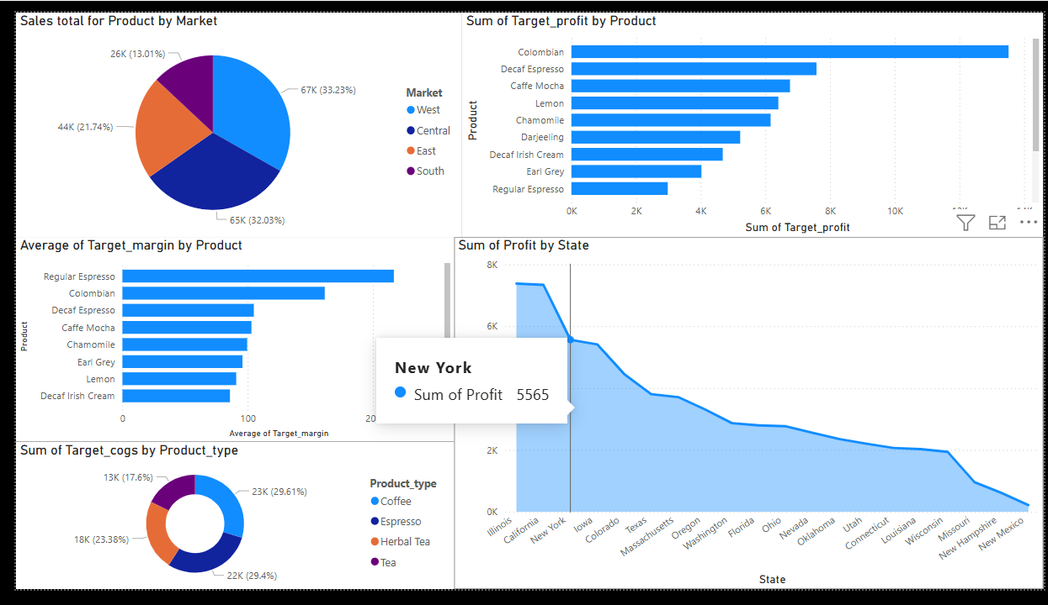

Slide 6
Charts 4, 5 & 6: Sales and Profit Breakdown
Sales by Product Line and Type
Stacked bar chart showing product line and type performance.
Total Sales by Market
Bar chart displaying product sales across various markets.
Sum of Target Profit by Product
Bar chart identifying highest target profit products.

Slide 7
Thank you

